Slide 1
Sales Prediction for Supermarket Chain
By Enyonam Anyigba

Slide 2
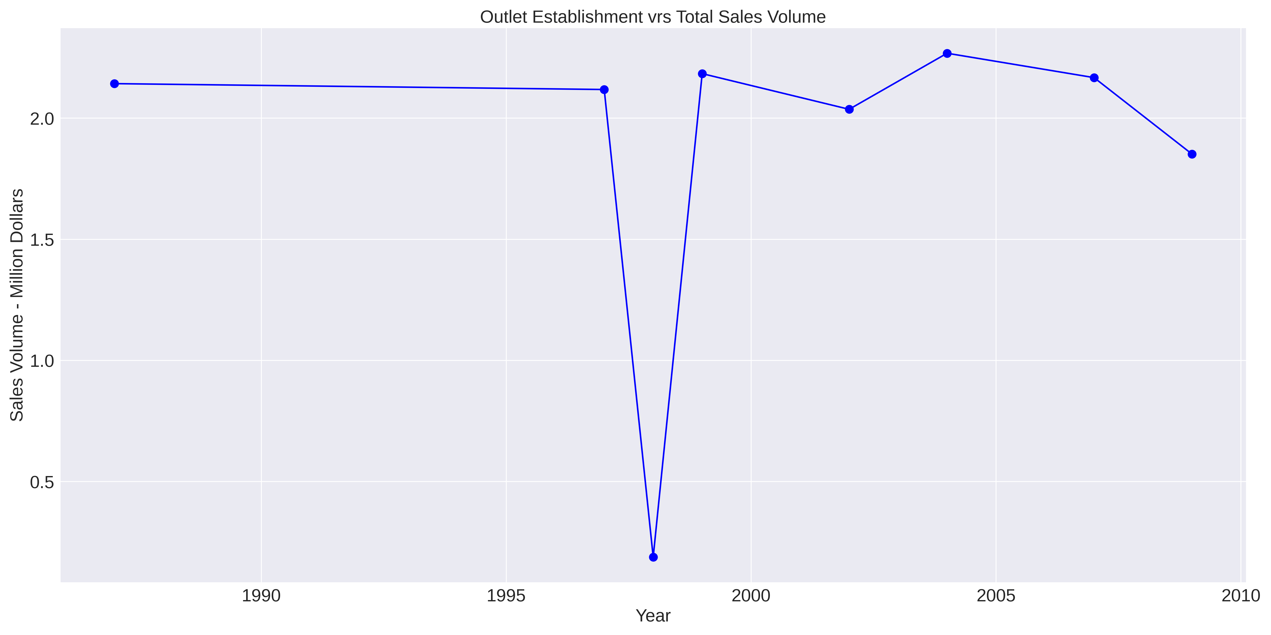
Total Sales
This is the total sales based on the establishment of the outlet. This shows that the oldest establishment has the largest sale - with the exception of the anomaly in the middle

Slide 3
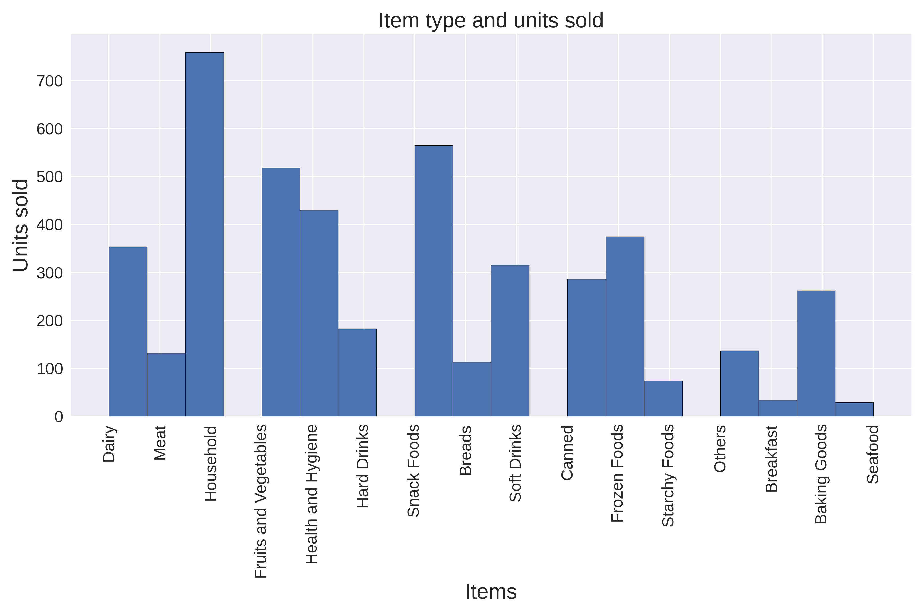
Total Sales Of types of items
The overall sale volume of items in the supermarket. Household items, followed by snack foods sell the best. Then

Slide 4
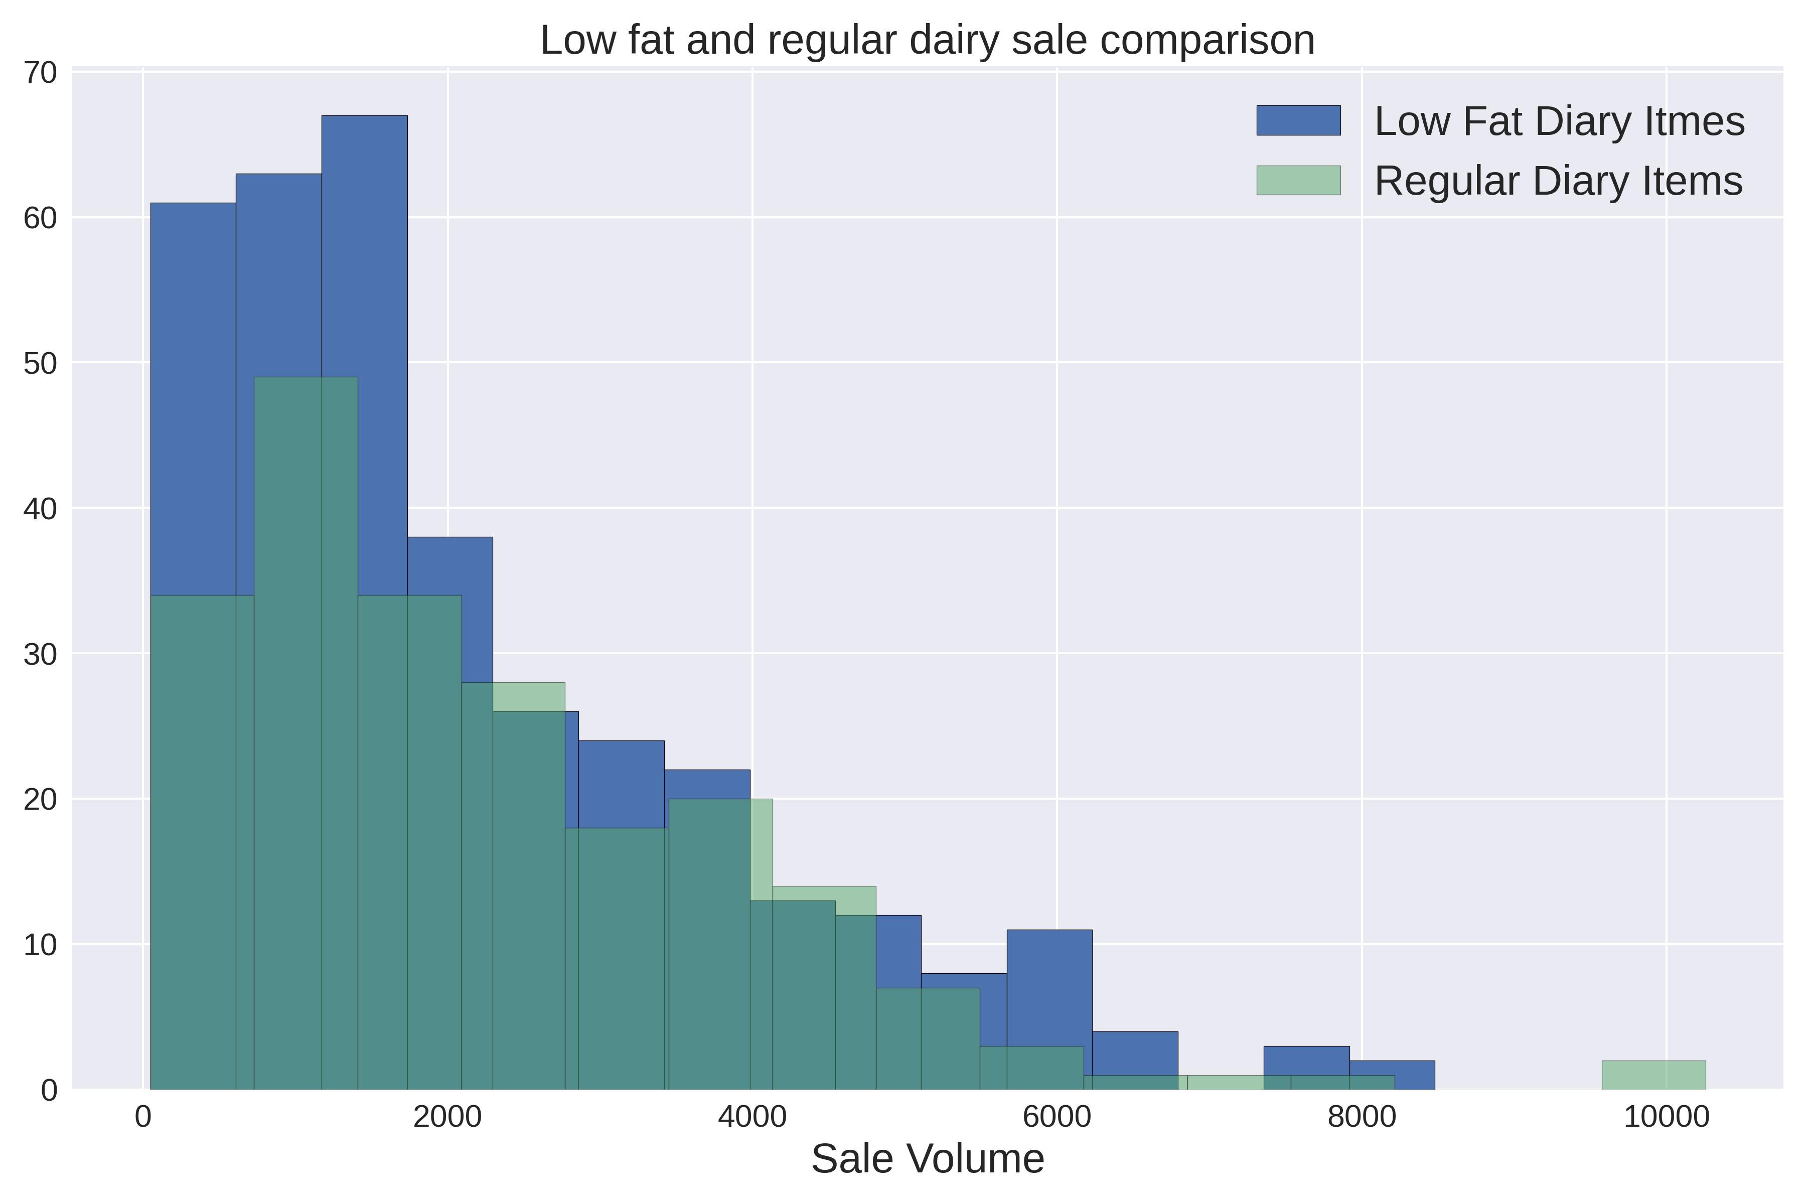
Diary item sale
Looking specifically at dairy items, we see that low fat dairy items sell better than regular dairy items, indicating that buyers are health conscious.

Slide 5
Sales Prediction Model

Slide 6
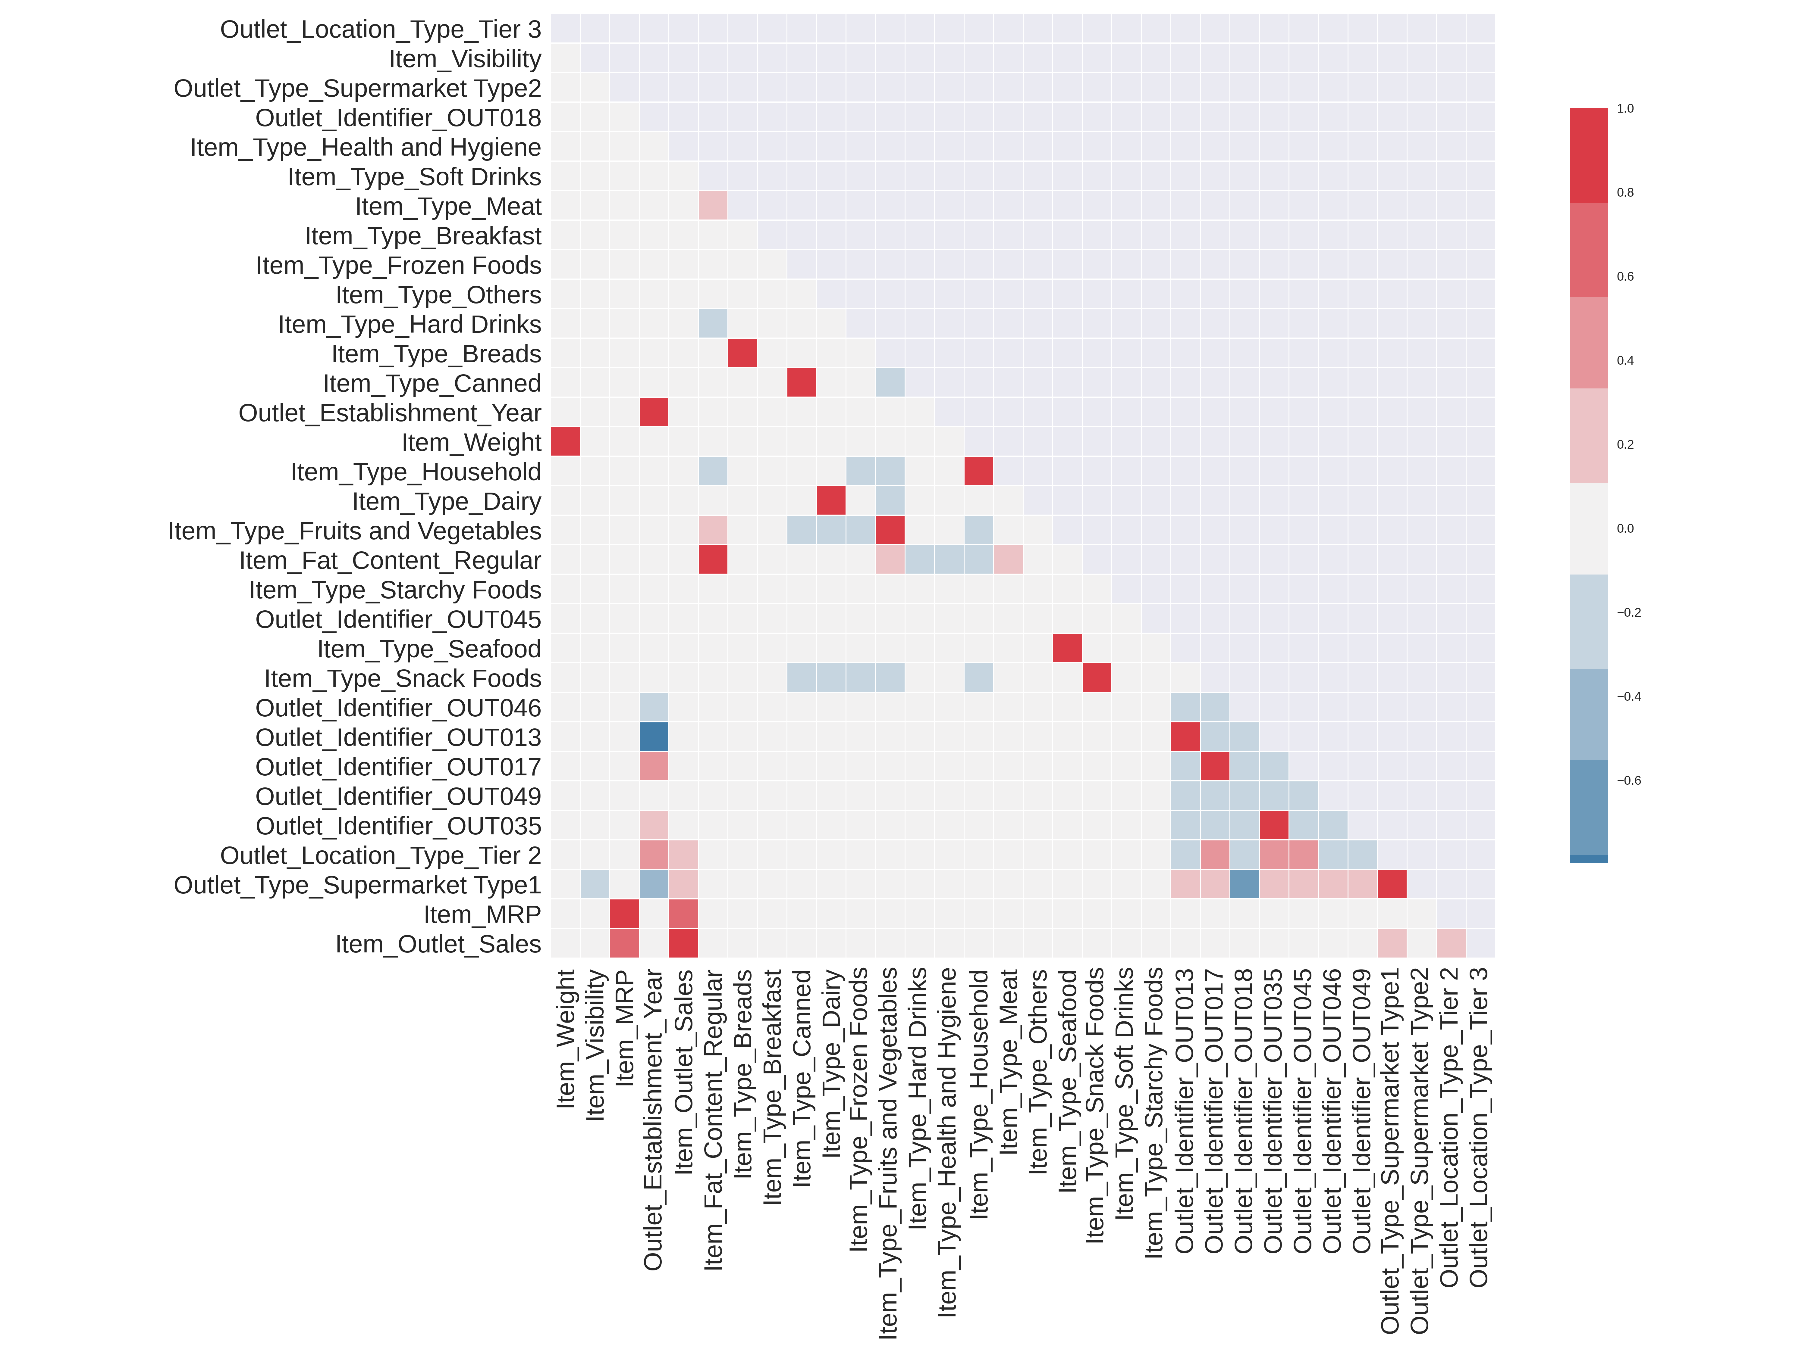
Feature Correlation
Feature correlation shows that, item MSRP, supermarket type, location, and to a smaller extent item visibility

Slide 7
Model Prediction Score and interpretation
A linear regression model was used to predict sales volume
Item MSRP is shown as the most important component of sale volume
The model is able predict sale volume with a 51percent accuracy
The score is the R² regression model score which predicts the proportion of the variation in y that is explained by x

Slide 8
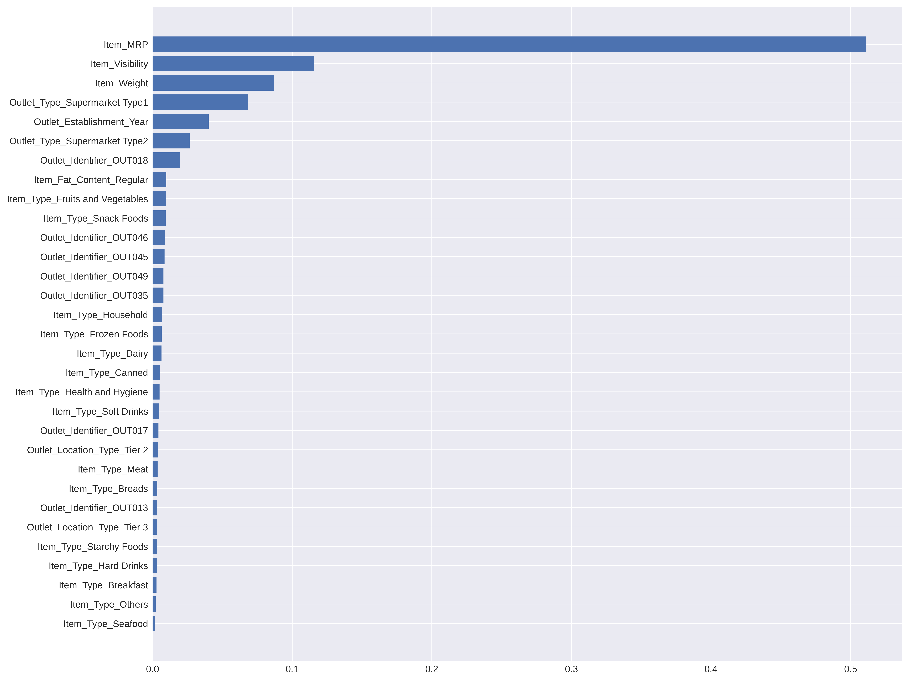
Model Prediction Score and interpretation
A random forest regression was also used to predict sales volume as a comparison
Item MSRP is still shown as the most important component of sale volume
The model is able predict sale volume with a 47 percent accuracy

Slide 9
Thank You

